Slide 1
International Strategy

Slide 2
An organization has to make a gamut of decisions before it enters the global market. It has to resolve three basic questions which may be related to each other
1) Which foreign markets to enter, when to enter and to what extent i.e. level of involvement?
2) What would be the choice of the entry mode? and
3) What would be the role of strategic alliances, if any?
An organization planning to ‘go-global’ has to decide its entry mode and strategy.
Accordingly, it has to evaluate the prevailing business environment that might affect its decision to go global.
The scanning of global business environment which is also referred as PESTEL analysis helps us probe the issues and challenges involved in deciding the appropriate entry for an international market.

Slide 3
There are four different common strategies businesses use to expand internationally:
International strategy
Multidomestic strategy
Global strategy
Transnational strategy
Consider each of these strategies on a spectrum between two elements: local responsiveness and global integration.

Slide 4
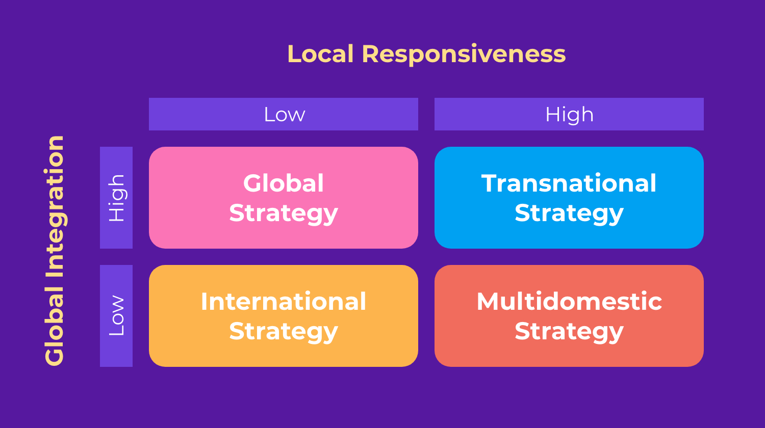

Slide 5
International Strategy
The international strategy, often called the exporting strategy, is about distributing locally sourced products with minimal adaptation to foreign markets while centralizing production and operations in your domestic market. So, we can say that it’s an approach that seeks a middle ground between low local responsiveness and low global integration.
Many brands choose international business strategies in the early stages of their expansion for many reasons:
Testing products and competitiveness in local markets before large-scale entry, minimizing investment risks.
Lowering the costs of investment infrastructure, workforce, and customer support in different countries.
Ensuring efficient supply chain management and production within a single location.

Slide 6
International business strategies also come with several drawbacks.
The financial burden of shipping products to foreign markets and the high cost of taxes in the long run.
The challenges of maintaining smooth trade operations and compliance with foreign trade regulations from abroad.
Exchange rate fluctuations risks which might lead to instability and increased costs.
Keeping up to date with changing export rules, product standards, customs documentation requirements, and more.

Slide 7
Global Strategy
A global strategy concentrates decision-making power and operational control entirely at the corporate headquarters. Local subsidiaries are in this case totally dependent on the HQ (or the parent company) acting as pipelines of products and strategies.
And this is why companies that follow this approach have standardized product offerings, brand image, marketing, and overall customer experience across all markets without tailoring for local cultural differences.
So, we can say that global companies focus on consistency, efficiency, and scale through uniformity rather than localization to be able to:
Build a solid brand identity that is easily recognizable with fewer operational hassles.
Leverage economies of scale by having one standard product line which contributes to lower costs per unit.

Slide 8
Despite the advantage of unifying operations and branding, some risks still exist if you’re completely detached from local expectations and become culturally irrelevant. As such, investing in some level of localization to keep local customers engaged and satisfied becomes necessary.
And while there is no right amount of adaptation required, at least your products or services, app, website, and marketing material should be comprehensible and functional for target consumers.

Slide 9
Multi Domestic Strategy
Unlike the global strategy, this local-focused approach prioritizes local responsiveness over global upscaled production. This means you tailor everything, from your products, marketing, and the customer experience to the unique preferences of each locale.
And to be fully adaptive and responsive to every target market, multidomestic companies have local subsidiaries operating independently from the established headquarters to better serve each market independently.
By following a multidomestic strategy, you can:
Gain a great competitive advantage by capitalizing on local trends and market gaps to differentiate your brand and outperform local competitors.
Provide local consumers with a highly personalized experience to drive higher satisfaction and loyalty rates.

Slide 10
some of the challenges that come with implementing a multi-domestic business strategy include:
Extensive time and on-ground resources are necessary to research target markets and develop a distinct strategy that aligns with each country.
Producing locale-specific products and marketing materials can lead to higher operational and production costs.

Slide 11
Transnational Strategy
A transnational strategy combines elements of global and multi-domestic strategies by prioritizing both local responsiveness and global integration by striking the right balance between them.
They standardize backend manufacturing and distribution across countries to achieve economies of scale. However, when interacting with local markets, they allow for flexibility and localization in promotional messaging and sales channels.
As they do so, countries that implement a transnational strategy expand their operations at a full scale in various markets while operating primarily from the headquarters in the home country.

Slide 12
By doing so, these companies can enjoy the benefits of a unified brand — which are:
The ability to compete with both global and local companies.
The advantage of optimizing production for maximum efficiency leads to lower average costs per unit and greater economies of scale.
Access to worldwide resources, infrastructure, and local capabilities drives innovation, boosts efficiency, and reduces costs.

Slide 13
Factors influencing Entry Modes
The market entry factors for any organization depend on several external factors such as:
Market attractiveness
Country risks
Government policies
Timing
Internal capabilities
Cost benefit analysis

Slide 14
Modes of Entry
1. Exporting and Importing
Exporting and Importing is a very common mode to enter into International business. Selling goods and services to a company in a foreign country is referred to as Exporting.
Purchasing goods from a foreign company is known as Importing. Important Ways to Export and Import
i) Direct Importing/ Exporting: The company handles all of the necessary paperwork for the shipment and financing of goods and services and deals directly with foreign suppliers or purchasers.
ii) Indirect Importing/ Exporting: The company uses a middleman to handle all the paperwork and negotiate with foreign suppliers or customers. The firm’s involvement is limited.

Slide 15
2. Contract Manufacturing
According to Contract Manufacturing, every well-known company in a nation accepts responsibility for promoting the goods and services created by a business in another nation.
Here, the company is specialized in the manufacturing process but lacks marketing skills, whereas the other company, due to its established reputation, is capable of selling those items and services.
Offering these items and services is not the primary business of these organizations, but they do it for the benefit of their name and reputation, as well as to provide high-quality products at a low cost to their customers.
Contract manufacturing is also known as international outsourcing.

Slide 16
3. Licensing
When a corporation from one country (the Licensor) grants a license to a company from another country (the Licensee) to use its brand, patent, trademark, technology, copyright, marketing skills; etc., to assist the other firm sell its products, this contractual agreement is referred to as Licensing.
The licensor corporation receives returns in proportion to sales.
The company that provides such authorisation is known as the Licensor while the other company in a different country that receives these rights is known as the Licensee.
The mutual sharing of knowledge, technology, and/or patents between the companies is called Cross-licensing.

Slide 17
4. Franchising
The franchise is the unique right or freedom that a producer grants to a certain person or group of people to establish the same business at a specific location.
The producers use this contemporary business model to market their products in far-off locations.
In general, producers who have a good reputation use this system.
Individuals are motivated by their goodwill and try this mode of business in order to earn profit.
The business that gives the rights (i.e., the parent company) is referred to as the Franchisor, and the business that purchases the rights is referred to as the Franchisee.

Slide 18
5. Joint Ventures
A joint venture is formed when two or more businesses decide to work together for a common goal and mutual benefit.
These two commercial entities could be private, public, or foreign-owned.
Joint ventures are those types of businesses that are established in international trade where both domestic and foreign entrepreneurs are partners in ownership and management.
The trade is carried out in collaboration with the importing nation’s firm.
For instance, the Joint venture of the Indian company Maruti with the Japanese Company Suzuki.

Slide 19
6. Wholly Owned Subsidiary
When a foreign company establishes a business unit or acquires a full stake in any domestic company, then they are called a Wholly-owned Subsidiary.
Wholly owned subsidiaries are set by a foreign company to enjoy full control over their overseas operations.
A wholly-owned subsidiary in a foreign country may be established in two ways:
Setting up of wholly-owned new firm in the foreign land, also called Green Field Venture.
Acquiring an established firm in a foreign country and using that firm to do business in a foreign country.

